Slide 1
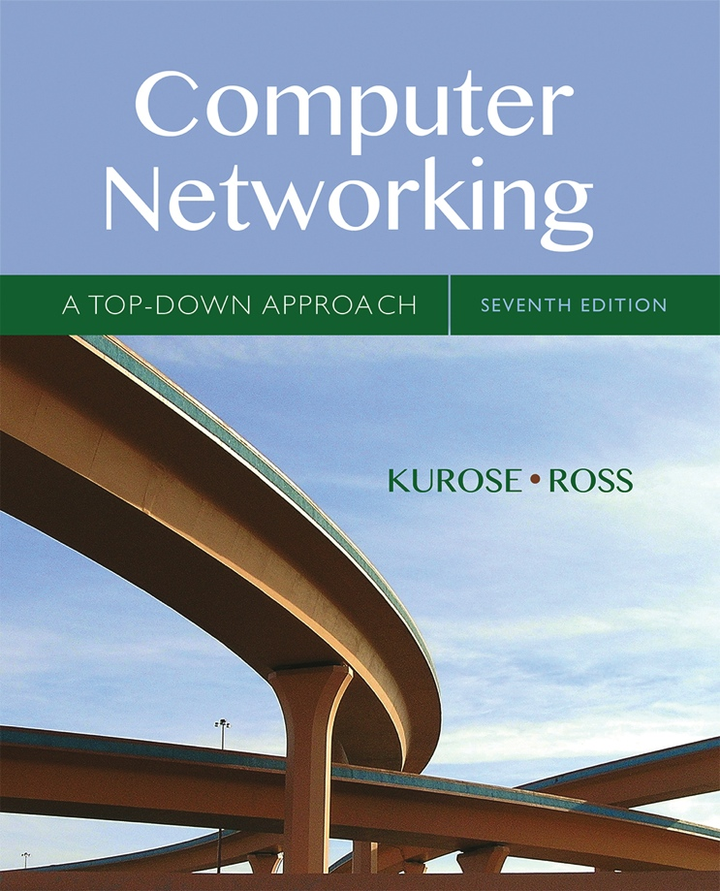
UNIT-2 Transport Layer
Acknowledgement
All material copyright 1996-2016
J.F Kurose and K.W. Ross, All Rights Reserved
Computer Networking: A Top Down Approach
Presented by
Dr.M.Kaliappan
Professor
Artificial Intelligence and Data Science
04.03.2023
7th edition Jim Kurose, Keith Ross Pearson/Addison Wesley April 2016

Slide 2
Unit-2: Transport Layer
Learning outcomes:
Describe principles behind transport layer services:
multiplexing, demultiplexing
reliable data transfer
flow control
congestion control
Explain Internet transport layer protocols:
UDP: connectionless transport
TCP: connection-oriented reliable transport
TCP congestion control

Slide 3

















Transport services and protocols
application
transport
network
data link
physical
provide logical communication between app processes running on different hosts
transport protocols run in end systems
send side: breaks app messages into segments, passes to network layer
receiver side: reassembles segments into messages, passes to app layer
more than one transport protocol available to apps
Internet: TCP and UDP
logical end-end transport
application
transport
network
data link
physical

Slide 4
Transport vs. network layer
network layer: logical communication between hosts
transport layer: logical communication between processes
relies on, enhances, network layer services

Slide 5
Internet transport-layer protocols
reliable, in-order delivery (TCP)
congestion control
flow control
connection setup
unreliable, unordered delivery: UDP
no-frills extension of “best-effort” IP
services not available:
delay guarantees
bandwidth guarantees
application
transport
network
data link
physical
network
data link
physical
network
data link
physical
network
data link
physical
logical end-end transport
network
data link
physical
network
data link
physical
network
data link
physical
network
data link
physical
application
transport
network
data link
physical

Slide 6
Unit2 outline
3.1 transport-layer services
3.2 multiplexing and demultiplexing
3.3 connectionless transport: UDP
3.4 principles of reliable data transfer
3.5 connection-oriented transport: TCP
segment structure
reliable data transfer
flow control
connection management
3.6 principles of congestion control
3.7 TCP congestion control

Slide 7

Multiplexing/demultiplexing
multiplexing at sender:
demultiplexing at receiver:
the transport layer examines these
Fields in segment to identify the receiving
socket and then directs the segment
to correct socket
The job of gathering data chunks at the source host from different sockets, encapsulating each data chunk with header information to create segments, and passing the segments to the network layer is called multiplexing
application
application
P1
P2
application
socket
P3
transport
P4
process
transport
network
transport
network
link
network
link
physical
link
physical
physical

Slide 8
To download webpage
Multiplexing/ De-multiplexing
IP Packet by network layer
Segment
sender
HTTP process: Port 80 + data
, TCPsocket
Multiplexing
FTP process: Port 21 + data
, UDPsocket
Segment
Transport layer
Email process: Port 25 + data
, TCPsocket
Segment
receiver
HTTP process: Port 80 + data
, TCPsocket
HTTP:80
De-multiplexing
FTP:21
FTP process: Port 21 + data
,UDPsocket
Email-25
Segment
Transport layer
Email process: Port 25 + data
, TCPsocket

Slide 9
How demultiplexing works
host receives IP datagrams
each datagram has source IP address, destination IP address
each datagram carries one transport-layer segment
each segment has source, destination port number
host uses IP addresses & port numbers to direct segment to appropriate socket
32 bits
source port #
dest port #
other header fields
application
data
(payload)
TCP/UDP segment format

Slide 10
Connectionless demultiplexing
recall: when creating datagram to send into UDP socket, must specify
destination IP address
destination port #
recall: created socket has host-local port #:
DatagramSocket mySocket1 = new DatagramSocket(12534);
when host receives UDP segment:
checks destination port # in segment
directs UDP segment to socket with that port #
IP datagrams with same dest. port #, but different source IP addresses and/or source port numbers will be directed to same socket at dest

Slide 11
Connectionless demux: example
DatagramSocket serverSocket = new DatagramSocket
(6428);
DatagramSocket mySocket2 = new DatagramSocket
(9157);
DatagramSocket mySocket1 = new DatagramSocket (5775);
application
application
P1
application
P3
P4
transport
transport
network
transport
network
link
network
link
physical
link
physical
physical
source port: 6428
dest port: 9157
source port: ?
dest port: ?
source port: 9157
dest port: 6428
source port: ?
dest port: ?

Slide 12
Connection-oriented demux
TCP socket identified by 4-tuple:
source IP address
source port number
dest IP address
dest port number
demux: receiver uses all four values to direct segment to appropriate socket
server host may support many simultaneous TCP sockets:
each socket identified by its own 4-tuple
web servers have different sockets for each connecting client
non-persistent HTTP will have different socket for each request

Slide 13
Connection-oriented demux: example
application
application
P4
P5
P6
application
P3
P2
P3
transport
transport
network
transport
network
link
network
link
physical
link
physical
server: IP address B
physical
host: IP address A
source IP,port: B,80
dest IP,port: A,9157
host: IP address C
source IP,port: C,5775
dest IP,port: B,80
source IP,port: A,9157
dest IP, port: B,80
source IP,port: C,9157
dest IP,port: B,80
three segments, all destined to IP address: B,
dest port: 80 are demultiplexed to different sockets

Slide 14
Connection-oriented demux: example
threaded server
application
application
application
P4
P3
P3
P2
transport
transport
network
transport
network
link
network
link
physical
link
physical
server: IP address B
physical
host: IP address A
source IP,port: B,80
dest IP,port: A,9157
host: IP address C
source IP,port: C,5775
dest IP,port: B,80
source IP,port: A,9157
dest IP, port: B,80
source IP,port: C,9157
dest IP,port: B,80

Slide 15
Unit 2 outline
3.1 transport-layer services
3.2 multiplexing and demultiplexing
3.3 connectionless transport: UDP
3.4 principles of reliable data transfer
3.5 connection-oriented transport: TCP
segment structure
reliable data transfer
flow control
connection management
3.6 principles of congestion control
3.7 TCP congestion control

Slide 16
UDP: User Datagram Protocol [RFC 768]
“no frills,” “bare bones” Internet transport protocol
“best effort” service, UDP segments may be:
lost
delivered out-of-order to app
connectionless:
no handshaking between UDP sender, receiver
each UDP segment handled independently of others
UDP use:
streaming multimedia apps (loss tolerant, rate sensitive)
DNS
SNMP
reliable transfer over UDP:
add reliability at application layer
application-specific error recovery!

Slide 17
UDP: segment header
length, in bytes of UDP segment, including header
32 bits
source port #
dest port #
length
checksum
why is there a UDP?
no connection establishment (which can add delay)
simple: no connection state at sender, receiver
small header size
no congestion control: UDP can blast away as fast as desired
application
data
(payload)
UDP segment format

Slide 18
UDP checksum
Goal: detect “errors” (e.g., flipped bits) in transmitted segment
sender:
treat segment contents, including header fields, as sequence of 16-bit integers
checksum: addition (one’s complement sum) of segment contents
sender puts checksum value into UDP checksum field
receiver:
compute checksum of received segment
check if computed checksum equals checksum field value:
NO - error detected
YES - no error detected. But maybe errors nonetheless? More later ….

Slide 19
Internet checksum: example
example: add two 16-bit integers
1 1 1 1 0 0 1 1 0 0 1 1 0 0 1 1 0
1 1 1 0 1 0 1 0 1 0 1 0 1 0 1 0 1
1 1 0 1 1 1 0 1 1 1 0 1 1 1 0 1 1
1 1 0 1 1 1 0 1 1 1 0 1 1 1 1 0 0
1 0 1 0 0 0 1 0 0 0 1 0 0 0 0 1 1
wraparound
sum
checksum
Note: when adding numbers, a carryout from the most significant bit needs to be added to the result
* Check out the online interactive exercises for more examples: http://gaia.cs.umass.edu/kurose_ross/interactive/
Notes:
Kurose and Ross forgot to say anything about wrapping the carry and adding it to low order bit

